Slide 1

Linux System Roles
One playbook to rule them all
Brian Dumont, RHCE
Sr. Solution Architect
Notes:
Intro Shirly and David

Slide 2
Simplified configuration with
Linux System Roles and Ansible
Overview of Linux System Roles
Introduction to Storage role
How to use it and demo time

Slide 3


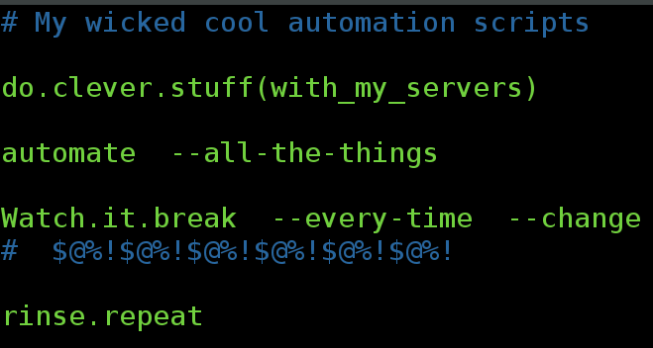
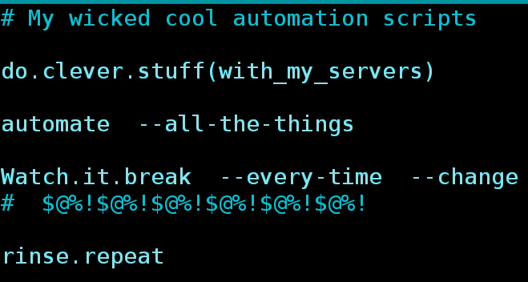
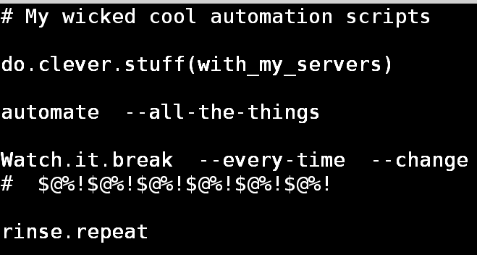
I bet you’ve been here before...
Image by www_slon_pics from Pixabay
Notes:
David:
Many of us have been here before.
An often-repeated scenario: Fancy automation scripts, broken by new releases
Remember when Fedora transitioned from sysvinit to systemd? How about from the sysv/sysconfig networking config files to NetworkManager? iptables to firewalld? I could go on.
These changes (aka: “progress” or “technological advancement”) present a real and ongoing problem for systems management.

Slide 4
Simplify the admin work
How can we make servers management easier,
in an automatable way,
at scale?
Image by www_slon_pics from Pixabay
Notes:
David
it’s not the “what”, but the “how”
still managing services, network interfaces, firewall rules, etc;
what changes is the tooling used to manage them.
we want a way to express the configuration in such a way as to convey the essential information without getting bogged down by the details of how we apply the settings in the OS
In other words, we need to abstract away the implementation details so the user can focus on the important parts: those that transcend any given implementation.

Slide 5

Easier Administration with
Ansible Playbooks
---
- hosts: all
- role: linux-system-roles.network
A collection of Ansible roles and modules
Linux System Roles
RHEL/CentOS
Fedora
Network
SELinux
TimeSync
kdump
Storage
Logging
Firewall
Tuned
NFS
Metrics
Identity
Boot
6.9
7
8++
28
29
30++
Notes:
Shirly
introduced with RHEL 7.4, but with each release we're adding new roles.
Make system management easier and more consistent across multiple versions of RHEL. So, the same System Role scripts for Network management can be used across RHEL 7 and RHEL 8 transparently.
Reducing the need to know how setting up the network stack changed between RHEL 7 and 8.

Slide 6
Easier Administration with
Ansible is an open source automation platform
It is very simple to setup and yet powerful.
Helps with configuration management, application deployment, task automation.
It can do IT orchestration, where you have to run tasks in sequence and create a chain of events which must happen on several different servers or devices.
It doesn’t use an agent on the remote host.
Notes:
Shirly
Ansible is an open source automation platform
It is very simple to setup and yet powerful.
Helps with configuration management, application deployment, task automation.
It can do IT orchestration, where you have to run tasks in sequence and create a chain of events which must happen on several different servers or devices.
It doesn’t use an agent on the remote host

Slide 7
Easier Administration with
Ansible Playbooks
---
- hosts: all
- role: linux-system-roles.network
A collection of Ansible roles and modules
Abstract configuration from implementation
Maintained by subject matter experts
Evolves with subsystem
Consistent configuration interface to RHEL/Fedora/CentOS
Compatible and tested with RHEL 6, 7, 8+ and Fedora
Linux System Roles
RHEL/CentOS
Fedora
Network
SELinux
TimeSync
kdump
Storage
Logging
Firewall
Tuned
NFS
Metrics
Identity
Boot
6.9
7
8++
28
29
30++
Notes:
Shirly
introduced with RHEL 7.4, but with each release we're adding new roles.
Make system management easier and more consistent across multiple versions of RHEL. So, the same System Role scripts for Network management can be used across RHEL 7 and RHEL 8 transparently.
Reducing the need to know how setting up the network stack changed between RHEL 7 and 8.
FUTURE PROOF your automation

Slide 8


Easier Administration with
Ansible Playbooks
---
- hosts: all
- role: linux-system-roles.network
RELEASED ROLES
TARGETED ROLES
Network
Security-Enhanced Linux (SELinux)
TimeSync
Email (Postfix)
kdump (kernel crash dump)
Storage
Logging
Image builder
Web Console (cockpit)
SAP Hana
MS SQL Server
Metrics
Network file system (NFS)
Bootloader
Firewall
More…
Linux System Roles
RHEL/CentOS
Fedora
Network
SELinux
TimeSync
kdump
Storage
Logging
Firewall
Tuned
NFS
Metrics
Identity
Boot
6.9
7
8++
28
29
30++
Roles in Demo
Notes:
Shirly
Officially released that are already supported and tested

Slide 9
Storage role
Principles
Simplify local storage configuration
provide a concise model to describe the storage layout
provide reasonable defaults where possible
handle non-essential details automatically
reuse existing storage management logic
Notes:
- storage is really complex; for most of us it doesn’t need to be
- default to lvm volumes with xfs file systems; maybe in Fedora 35 we will default to stratis volumes, who knows? the interface will be unchanged.
- partition allocation is an implementation detail; you just tell us which disks to use and we handle the rest
- the backend is blivet, which is used by the OS installer (anaconda)

Slide 10
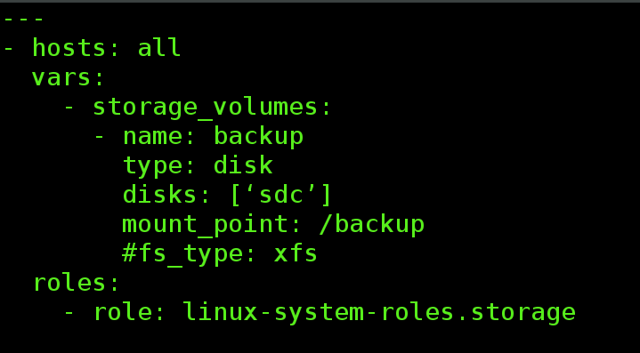
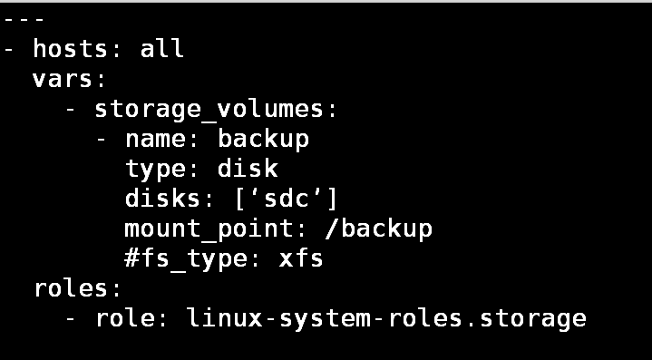
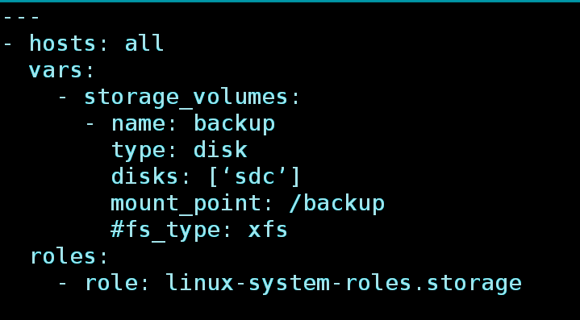
Storage role
Examples
Create and mount a file system on a whole unpartitioned disk (including /etc/fstab entry)
Notes:
The `storage_volumes` variable is a list of volumes to manage. Each volume has the following
variables:

Slide 11
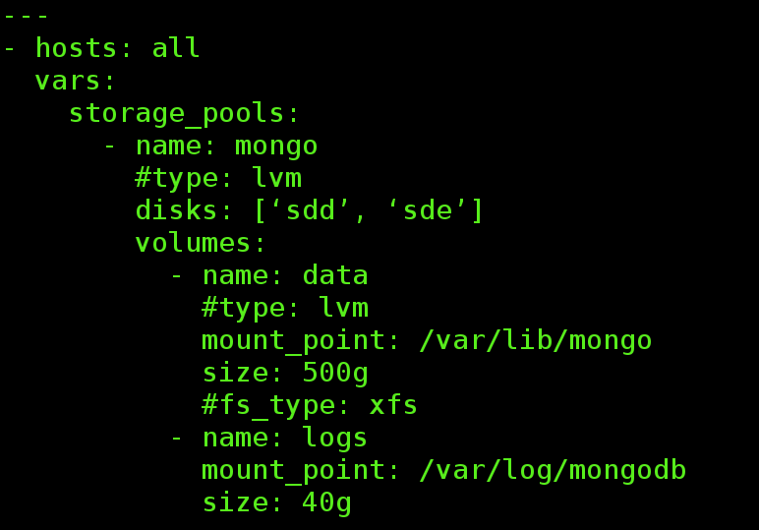
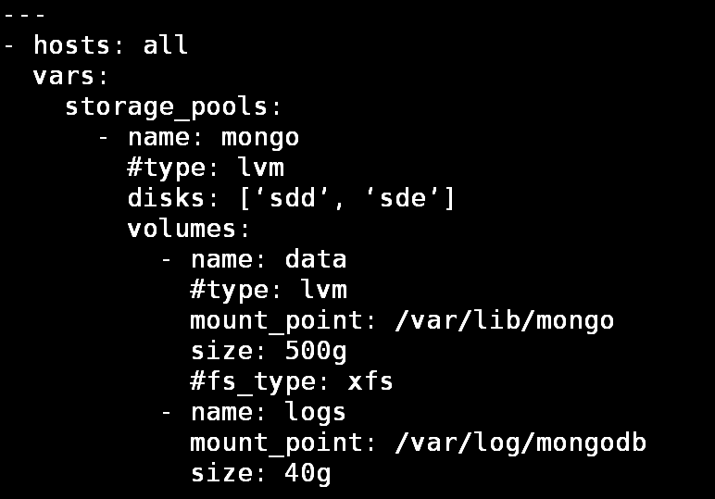
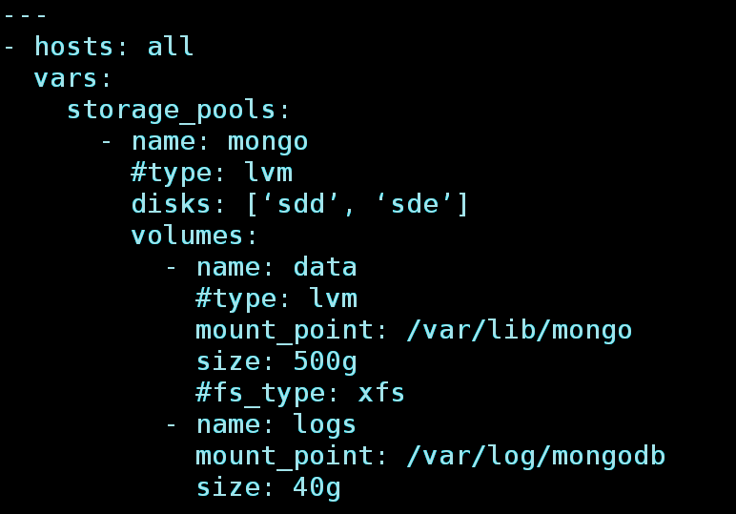
Storage role
Examples
Example: two (lvm) volumes in a single pool
Notes:
The `storage_pools` variable is a list of pools to manage. Each pool contains a
nested list of `volume` dicts as described below, as well as the following
keys:

Slide 12
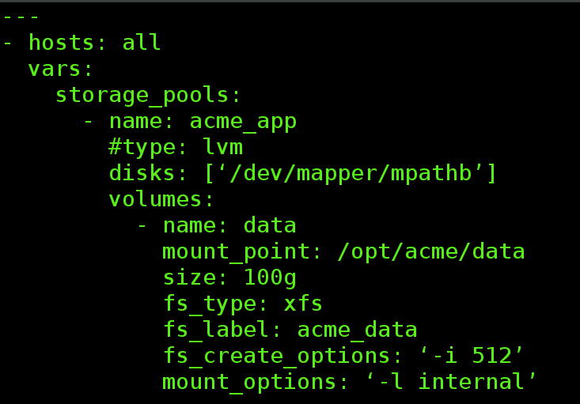
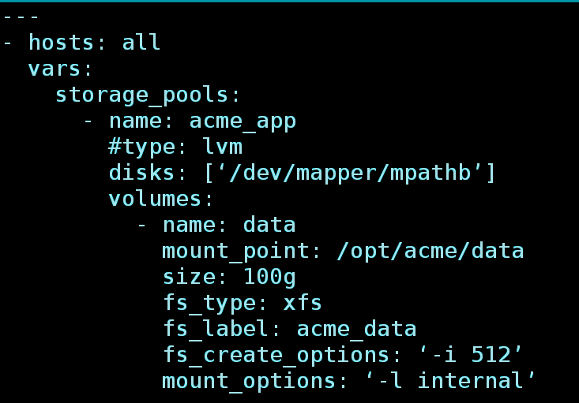
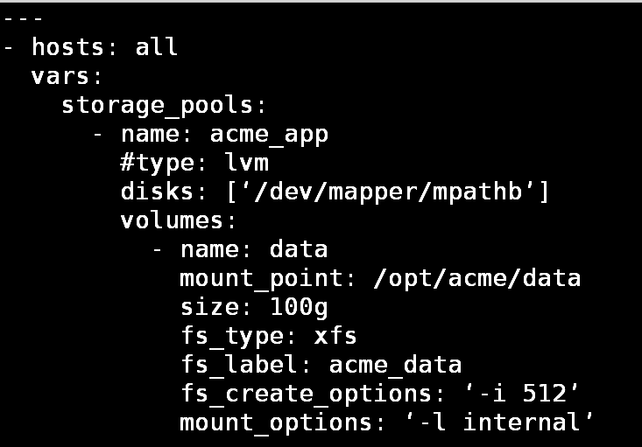
Storage role
Examples
Example: more options

Slide 13
Storage role
Status & Roadmap
Status
v1.0.2 released
planned for inclusion in RHEL 8.1.0, Fedora 32
supported
whole disk, whole disk w/ single partition, lvm (basic)
Roadmap
encryption (LUKS)
RAID (md)
LVM thin provisioning
LVM cache
LVM RAID
compression & deduplication (VDO)
stratis

Slide 14
Storage role
Challenges
Challenging, high-value features
automatic device name
automatic size
automatic disk selection
percentage-based size
Notes:
These are things we want to add, but don’t seem to fit well with certain aspects of ansible’s model: idempotence and determinism.
We hope to revisit these once we have an initial release.
I’m actually pretty optimistic about percentage-based sizes.

Slide 15
Logging role
Principles
High level architecture
Simplify logging deployment on multiple hosts
Collect multiple logs to multiple destinations
Apply default settings where possible

Slide 16
Logging role
Architecture
Rsyslog
Since Red Hat Enterprise Linux 6, November 2010, rsyslogd became the default.
Multi-threading
TCP, SSL, TLS, RELP
Diverse destinations
Filter any part of syslog message
Fully configurable output format
Suitable for enterprise-class relay chains

Slide 17

Logging role
By Default:
All system and kernel messages get passed to rsyslogd.
Logs are sent to files/ logged-in users based on their Syslog Facilities and Severity
Notes:
All system and kernel messages get passed to rsyslogd.
Logs are sent to files/ logged-in users based on their Syslog Facilities and Severity

Slide 18
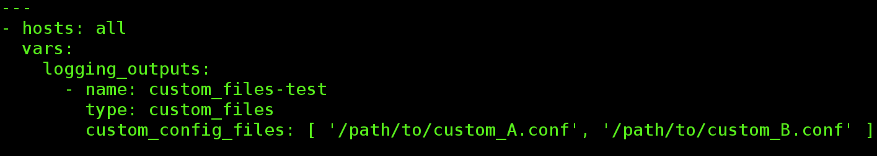
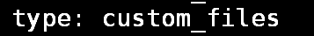
Logging role
User custom configuration file
List of custom configuration files are deployed to /etc/rsyslog.d/

Slide 19


Logging role
Journal to Elasticsearch

Slide 20
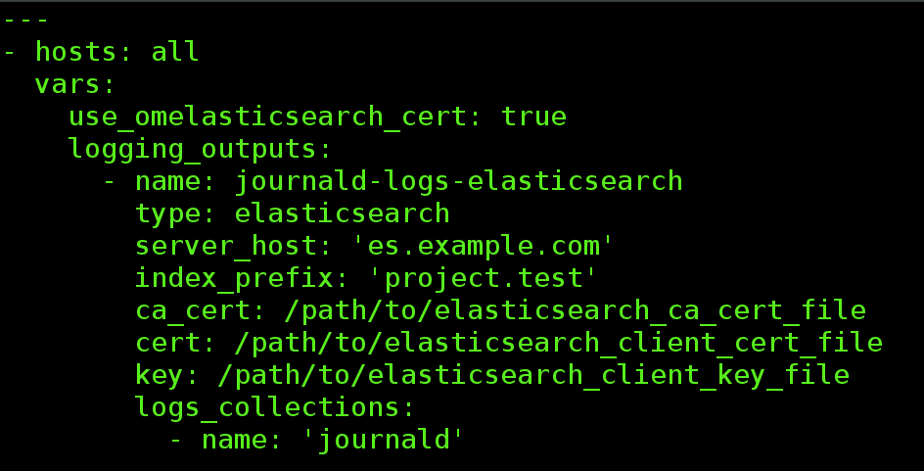
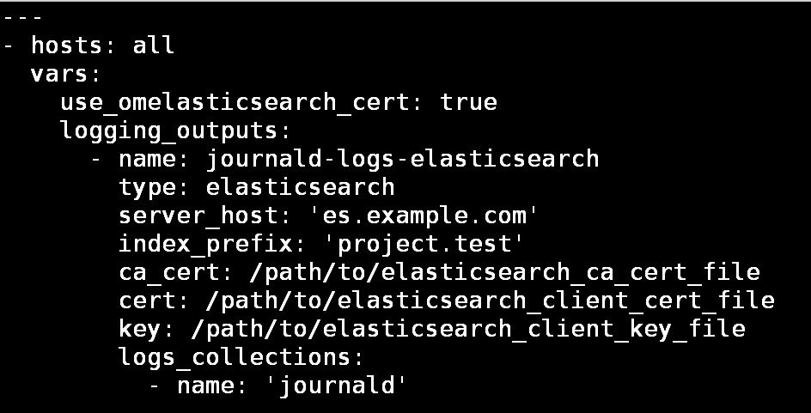
Logging role
Journal to Elasticsearch

Slide 21



oVirt - Full monitoring solution

Slide 22
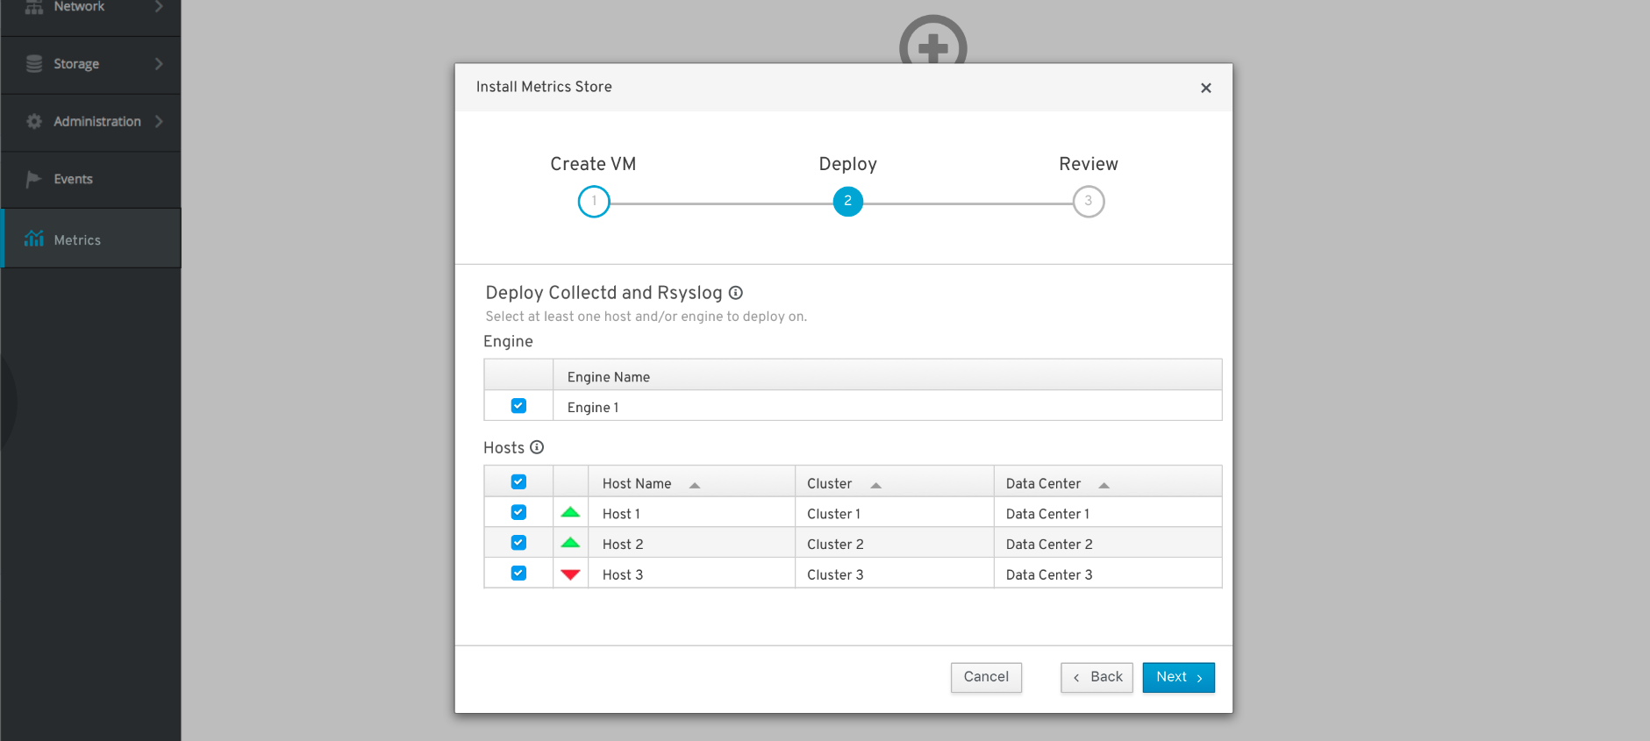
oVirt - Full monitoring solution

Slide 23
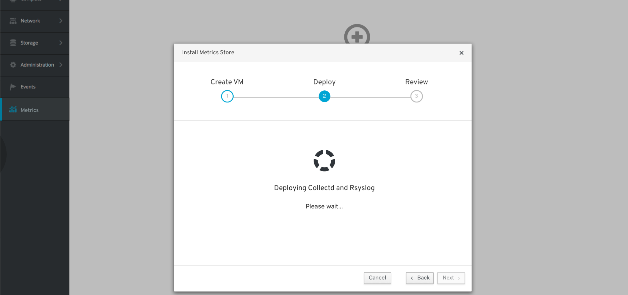
oVirt - Full monitoring solution

Slide 24
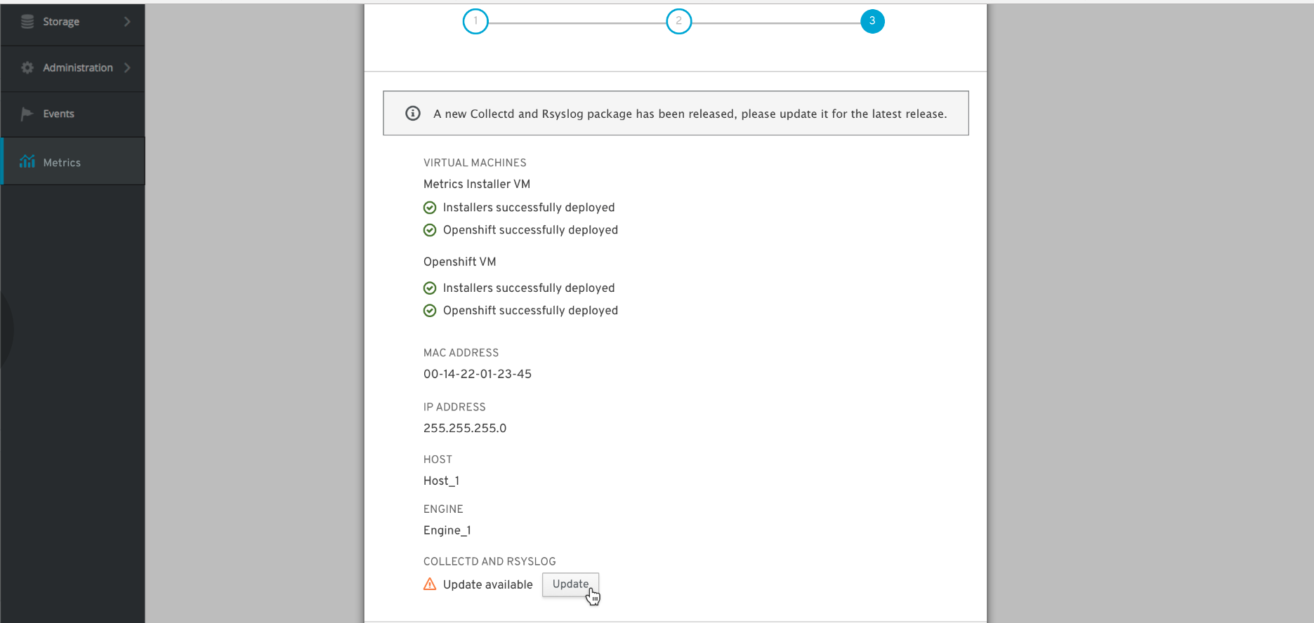
oVirt - Full monitoring solution

Slide 25
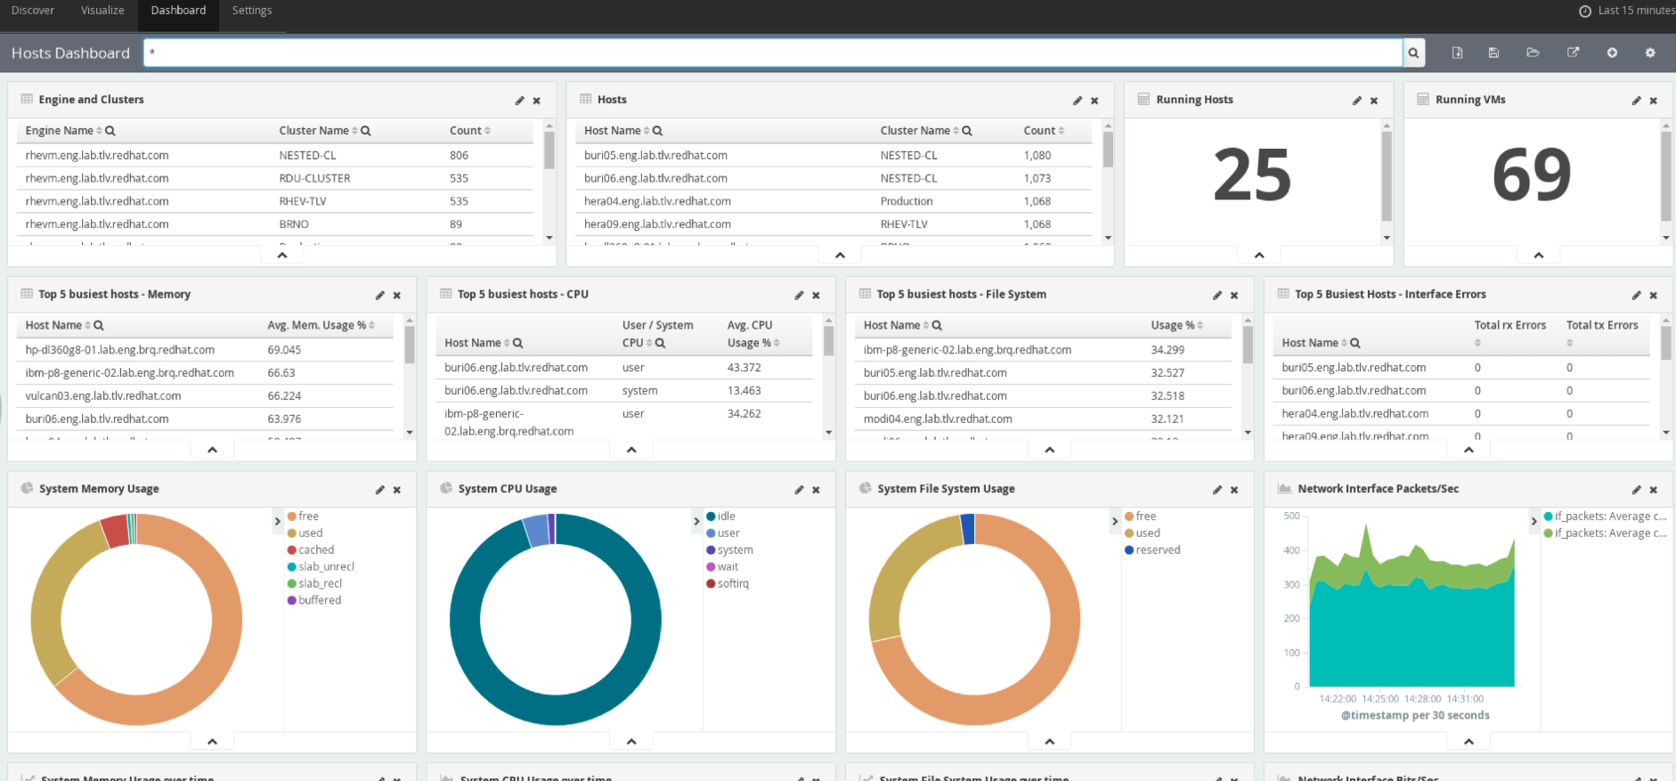
oVirt - Full monitoring solution

Slide 26
Logging role
Status & Roadmap
Status
In development
Supported
Deploy default rsyslog.conf
Send journal logs to Elasticsearch
Deploy custom configuration files
Used by oVirt for sending logs and Collectd metrics to Elasticsearch
Roadmap
Profile based configuration (General, Resilient, Security, etc.)
Additional inputs
Additional outputs:
Remote rsyslog (server/client)
Remote message bus (Kafka, AMQP)
Notes:
Profiles configuration - pre-created profiles to choose from, which adjust various rsyslog settings according to intended use-case

Slide 27

IT’S DEMO TIME!

Slide 28


Slide 29
Give it a try
# ansible-galaxy install linux-system-roles.postfix
# ansible-galaxy install linux-system-roles.kdump
# ansible-galaxy install linux-system-roles.network
# ansible-galaxy install linux-system-roles.selinux
# ansible-galaxy install linux-system-roles.timesync
# ansible-galaxy install linux-system-roles.storage
Notes:
Profiles configuration - pre-created profiles to choose from, which adjust various rsyslog settings according to intended use-case

Slide 30
Documentation & References
Landing page and overview -
https://linux-system-roles.github.io/
Link to Galaxy page -
https://galaxy.ansible.com/linux-system-roles/
Link github project -
https://github.com/linux-system-roles
Example playbooks
https://github.com/linux-system-roles/linux-system-roles.github.io/tree/master/demo
https://github.com/linux-system-roles/linux-system-roles.github.io/tree/master/demo/devconf-demo
Notes:
Profiles configuration - pre-created profiles to choose from, which adjust various rsyslog settings according to intended use-case

Slide 31
Providing Feedback & Requests
Tell us...
What new features or capabilities you need.
What is needed.
What needs to be fixed.
Methods...
Open an issue at the upstream linux-system-roles project on github.
Pull requests welcome!
Notes:
Profiles configuration - pre-created profiles to choose from, which adjust various rsyslog settings according to intended use-case

Slide 32
Thank you
Red Hat is the world’s leading provider of enterprise open source software solutions. Award-winning support, training, and consulting services make Red Hat a trusted adviser to the Fortune 500.

